Slide 1
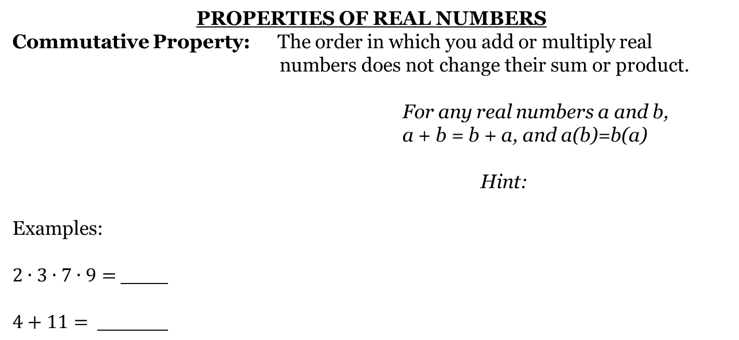
PROPERTIES OF REAL NUMBERS
Commutative Property: The order in which you add or multiply real numbers does not change their sum or product.
For any real numbers a and b,
a + b = b + a, and a(b)=b(a)
Hint:
Examples:
$2∙3∙7∙9=$
$4+11=$

Slide 2
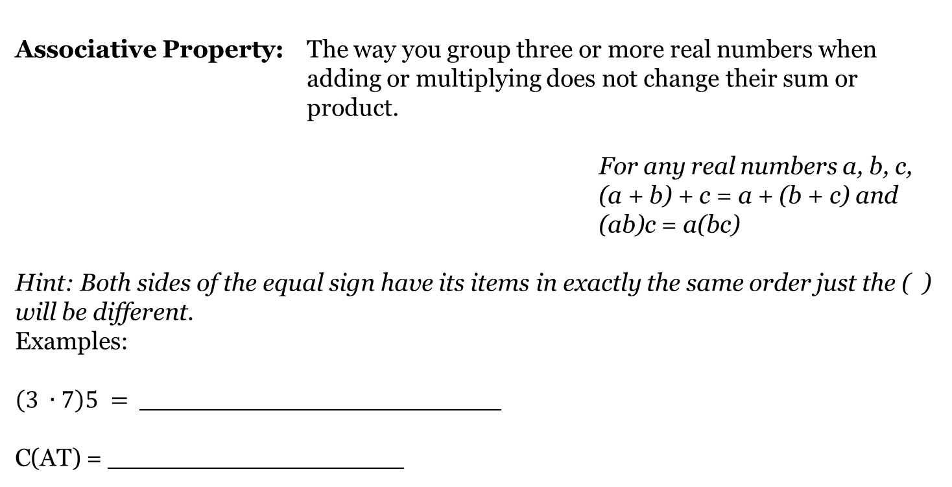
Associative Property: The way you group three or more real numbers when adding or multiplying does not change their sum or product.
For any real numbers a, b, c,
(a + b) + c = a + (b + c) and
(ab)c = a(bc)
Hint: Both sides of the equal sign have its items in exactly the same order just the ( ) will be different.
Examples:
$\left(3 ∙7\right)5 =$
C(AT) =

Slide 3
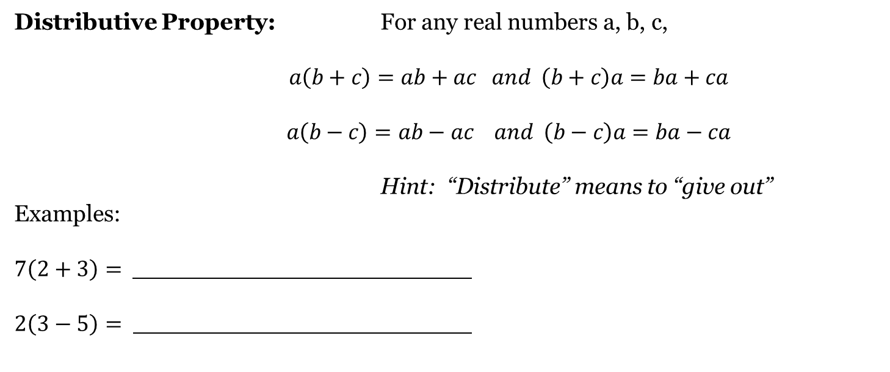
Distributive Property: For any real numbers a, b, c,
$a\left(b+c\right)=ab+ac and \left(b+c\right)a=ba+ca$
$$a\left(b−c\right)=ab−ac and \left(b−c\right)a=ba−ca$$
Hint: “Distribute” means to “give out”
Examples:
$7\left(2+3\right)=$
$2\left(3−5\right)=$

Slide 4
Examples:
3+ = 3
π+ = π
Identity: You will start off with a number, do “something” to it,
and end up with the identical number you started with.
Additive Identity: The sum of any real number and
zero is equal to the number.
Zero is called the additive identity.
Any # + = Any #

Slide 5
Multiplicative Identity: The product of any real number and one is equal to that number.
One is called the multiplicative identity.
Any #∙ = Any #
Examples:
8 ∙ = 8
π∙ = π

Slide 6
Inverse Properties
Additive Inverse: Two real numbers whose sum is zero are called additive inverses.
Additive Inverse: a number added to its opposite = 0
Examples:
The additive inverse of : 6 is ―7 is .85 is

Slide 7
Multiplicative Inverse: Two real numbers whose product is one are called multiplicative inverses or reciprocals. Zero has no reciprocal, since any number multiplied by it is zero.
Hint: Think of every number as a fraction.
Multiplicative Inverse: a number multiplied by its reciprocal = 1
Examples:
The multiplicative inverse of : 8 is ―3 is $\frac{−2}{7}$ is
Show work here:

Slide 8
LASTLY!!!!!
Division By Zero
Division by zero cannot be done !!!!
$\frac{8}{0}$ $\frac{\sqrt{12}}{0}$ $15 ÷0$
These are all UNDEFINED!!
When a denominator = zero the fraction is undefined.
For what value of x are the following undefined?
1.) $\frac{3}{x}$
2.) $\frac{4}{x+2}$
3.) $\frac{7}{x−5}$

Slide 9

Practice: *Check your properties*
Directions: Match column A with Column B
Column A Column B
1. Commutative Addition A) $14 ∙1=14$
2. Identity Addition B.) $23+12=12+23$
3. Commutative Multiplication C.) $24+\left(−24\right)=0$
4. Identity Multiplication D.) $6\left(7+2\right)=\left(6 ∙7\right)+\left(6 ∙2\right)$
5. Associative Addition E.) $51+0=51$
6. Multiplicative Inverse F.) $\frac{1}{9 }$ . 9 = 1
7. Associative Multiplication G.) $4+\left(9+3\right)=\left(4+9\right)+3$
8. Additive Inverse H.) $16 ∙21=21 ∙16$
9. Distributive I.) $\left(4 ∙8\right)∙7=4 ∙(8∙7)$

